Slide 1
TLS is the Best:
An analysis of TLS configurations for the web’s most popular commercial sites
COSC545: Digital Archeology
Fall 2021

Slide 2




Team TLS
Benjamin Greenberg GRADUATE STUDENT
Data collection, database administration, data analysis
Spencer Howell GRADUATE STUDENT
Data collection, report and presentation author
Daniel Troutman GRADUATE STUDENT
Data collection, data aggregation, data analysis
Dr. Audris Mockus PROFESSOR
Advisor

Slide 3
Objective: Analyze TLS configurations used by popular commercial websites to better understand the modern state of web security.

Slide 4
Transport Layer Security (TLS)
Ensures secure communication over network
Client and server agree on method to communicate securely (ciphersuite)
Used in HTTPS to secure web traffic

Slide 5
TLS Version History
Never publicly released
Released 1996
Deprecated 2015
Released 2006
Deprecated 2020
Released 2018 Currently supported
SSL 1.0
SSL 2.0
SSL 3.0
TLS 1.0
TLS 1.1
TLS 1.2
TLS 1.3
Released 1995
Deprecated 2011
Released 1999
Deprecated 2020
Released 2008
Currently supported

Slide 6
Data Collection
MAGNIFICENT MILLION
Top 10,000 .com domains, CSV format
PYTHON REST API
Make API call for each domain asynchronously
SSL LABS API
Run tests on each domain’s SSL configuration
PYTHON/PYMONGO
Insert JSON responses to database
MONGO DB
Reorganize data for analysis
DATA SET
Final result

Slide 7
10,000+ API calls
8,981 successes
24,177 endpoints
to SSL Server Test by SSL Labs
Most popular .com domains, ranked by referring subnet count
Many domains use multiple servers

Slide 8
Results

Slide 9
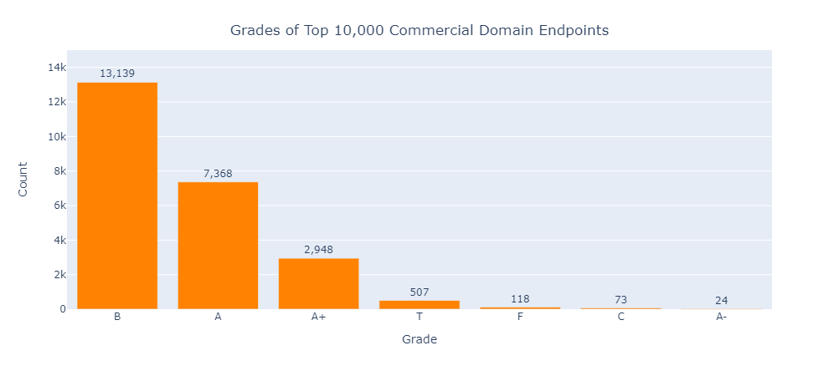
Grade

Slide 10
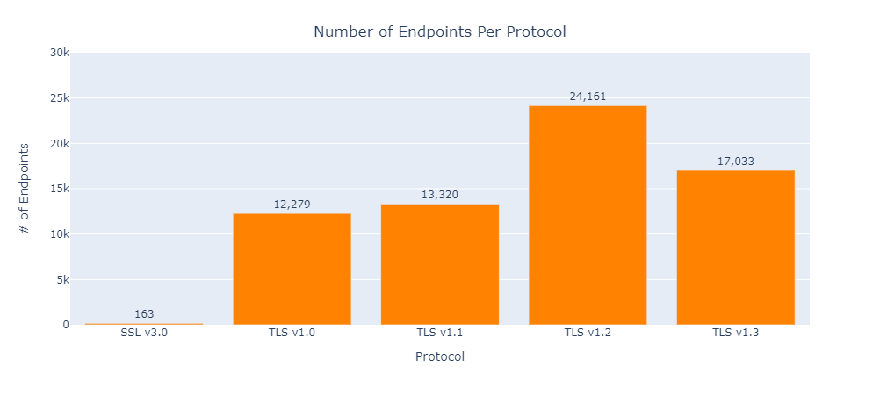
Supported SSL/TLS Versions

Slide 11
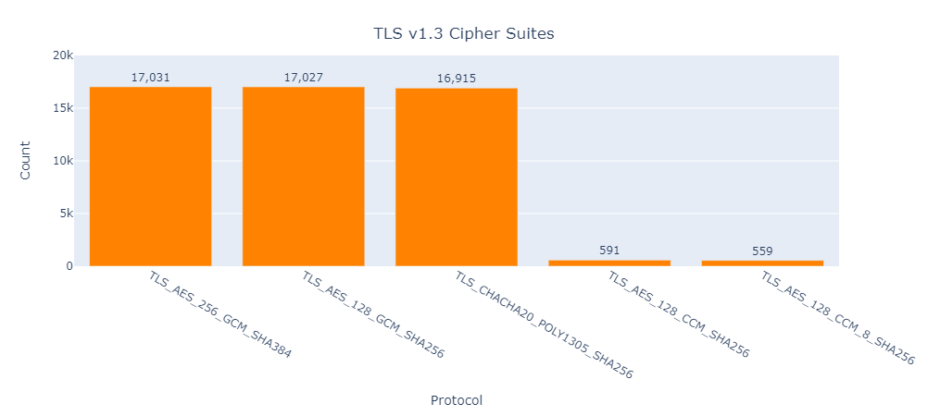
Supported Ciphersuites

Slide 12
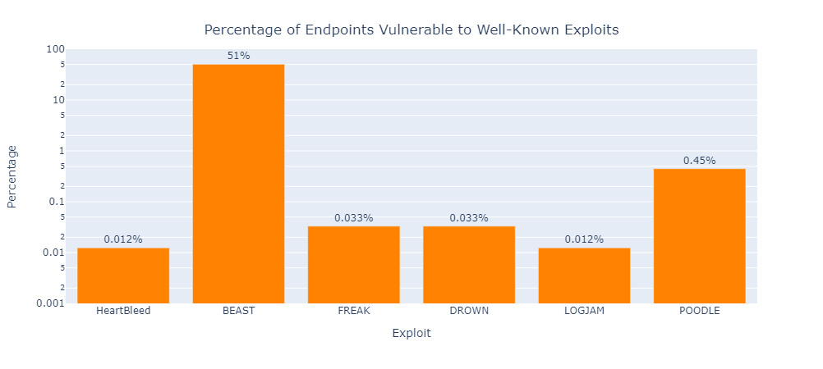
Vulnerabilities

Slide 13
Root Certificates
151 Unique Root Certificates
Popular Root Certificates
Baltimore CyberTrust Root (DigiCert) - 2,142
ISRG Root X1 (Let's Encrypt) - 1,888
DST Root CA X3 (Let's Encrypt – expired 09/21) - 1,748

Slide 14
Conclusions
Most websites are secure!
Almost all had grade of A or B
Biggest problems:
Supporting TLS 1.0 and older
BEAST vulnerability
Utilizing expired Root CA

Slide 15
Issues
Throttling by SSL Labs API
~1 minute per run
Restricted to 5 requests at a time
Data storage and sharing
Over 1GB of JSON data!
Hosted on Raspberry Pi

Slide 16
Future Work
Would use local tool that does not throttle (OpenSSL)
Expand data collection scope
Non-commercial websites
Less popular websites

Slide 17
Thanks!
Any questions?
https://github.com/fdac21/WhyJohnnyCantWinMedals (github.com)

Slide 18
References
The Evolution of SSL and TLS | DigiCert.com
SSL Server Test (Powered by Qualys SSL Labs)
Majestic Million - Majestic
Server Technologies - HTTPS BEAST Attack | Context Information Security (contextis.com)

